Slide 1
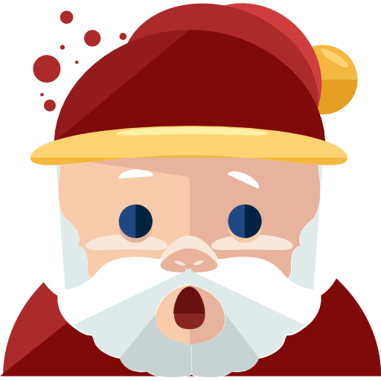
Mega Dungeon Fighter
Boris Fuchs, jakob spirk

Slide 2
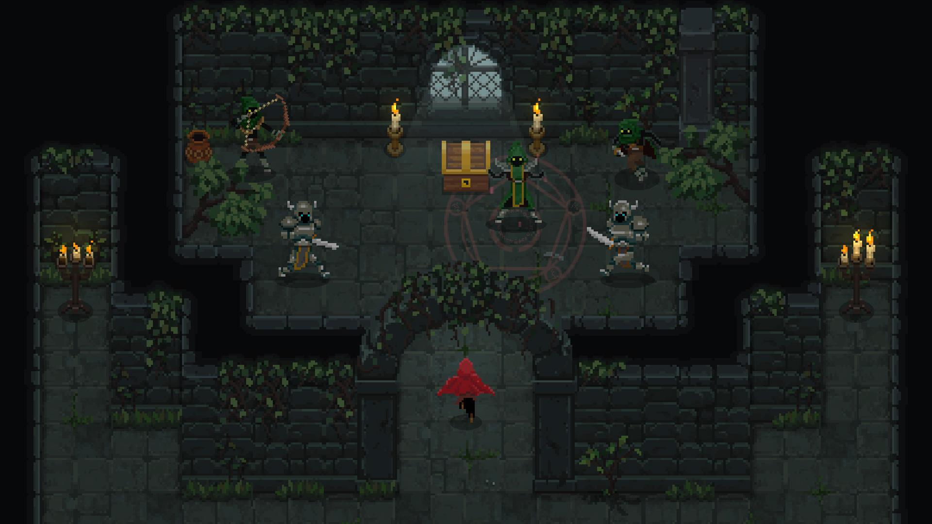

idea
Dungeon fighter
2d
Android

Slide 3
Gameplay
Big dungeon
enemies
Level up
Search and destroy the boss
Game sound

Slide 4
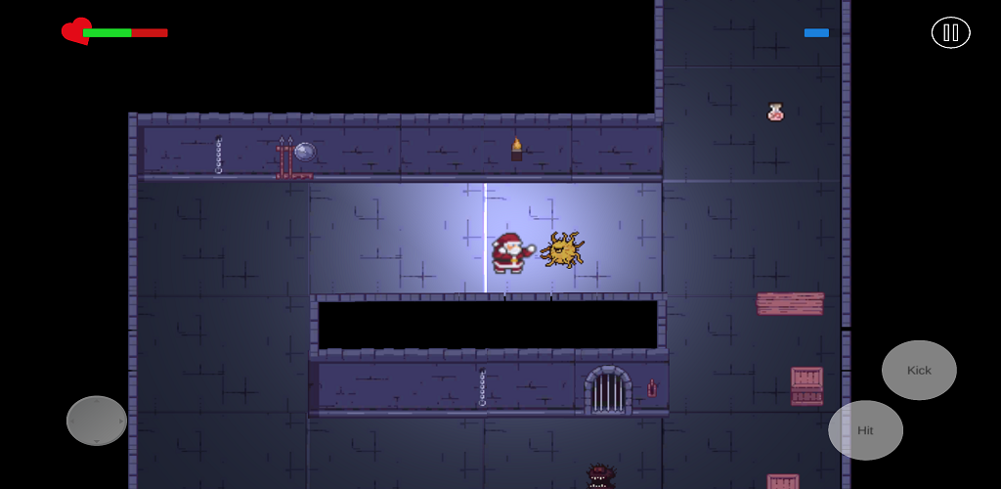
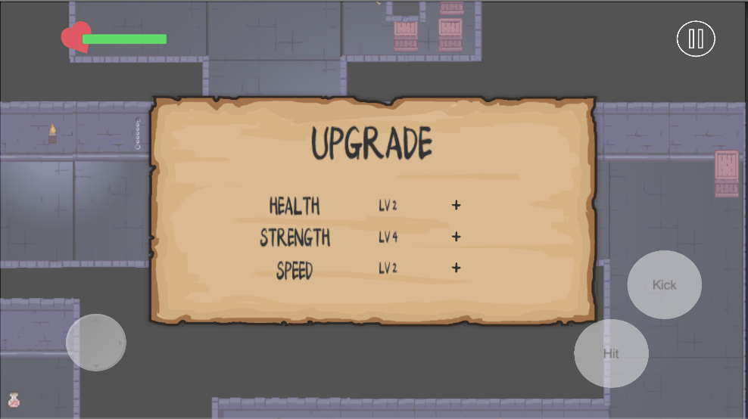
Features
Fighting
Gain experience
Character upgrade
Gain health

Slide 5
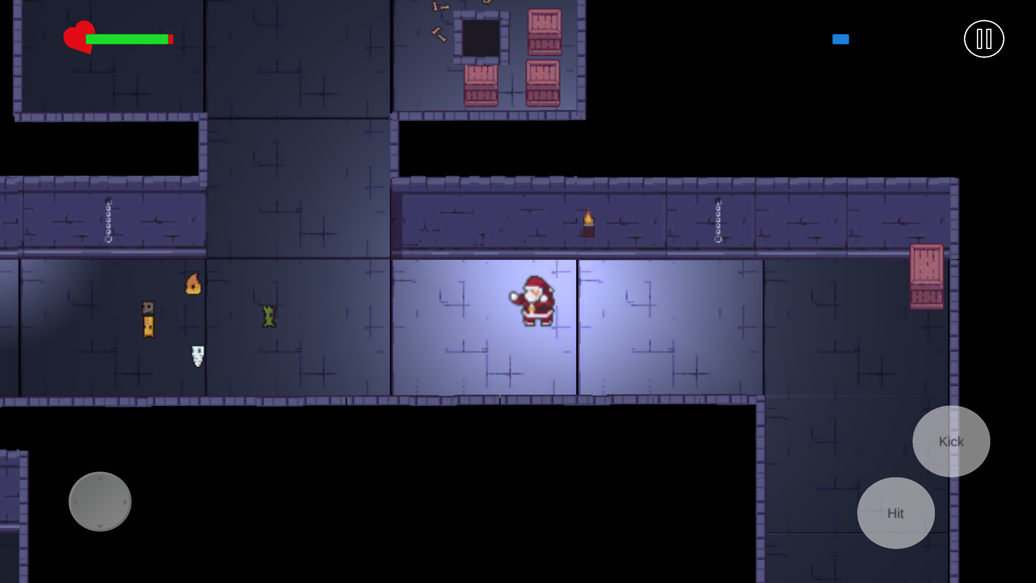
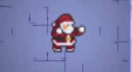
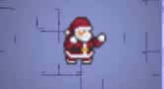
controls
Joystick to move
Buttons to fight

Slide 6
Who did what?
Boris
Game design
Sound
Enemy movement
Light effects
Jakob
Controls
Fighting
GUI
Animations

Slide 7
Scripts
Santa controller
Enemy controller
Game controller
Healthdrink controller
Startgui manager

Slide 8
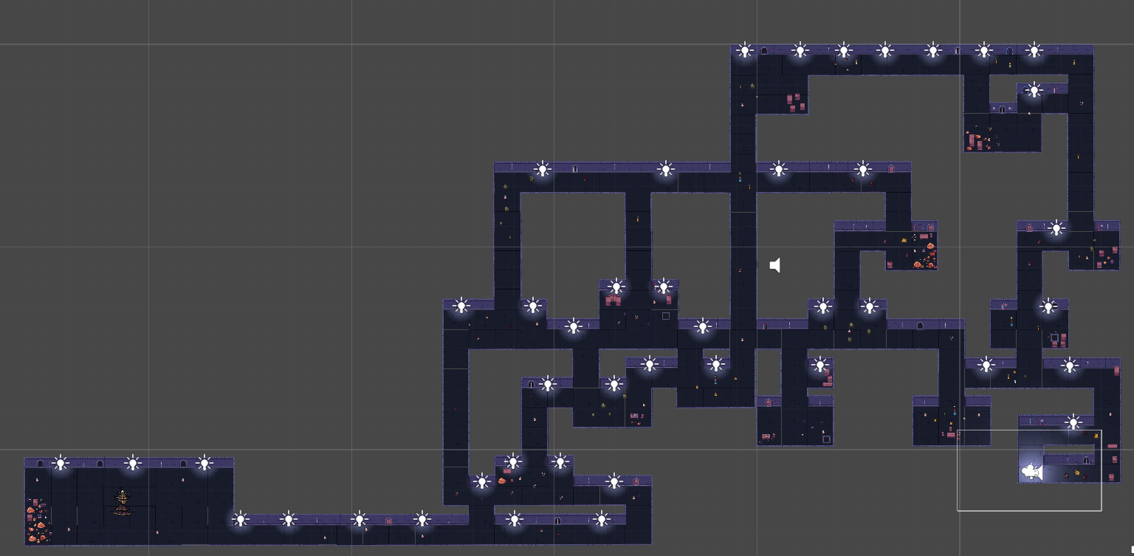
Current state
One huge fully playable dungeon
available on google play store

Slide 9
Possible updates
More dungeons
Better animation on enemies
Several characters

Slide 10
Demo

Slide 11
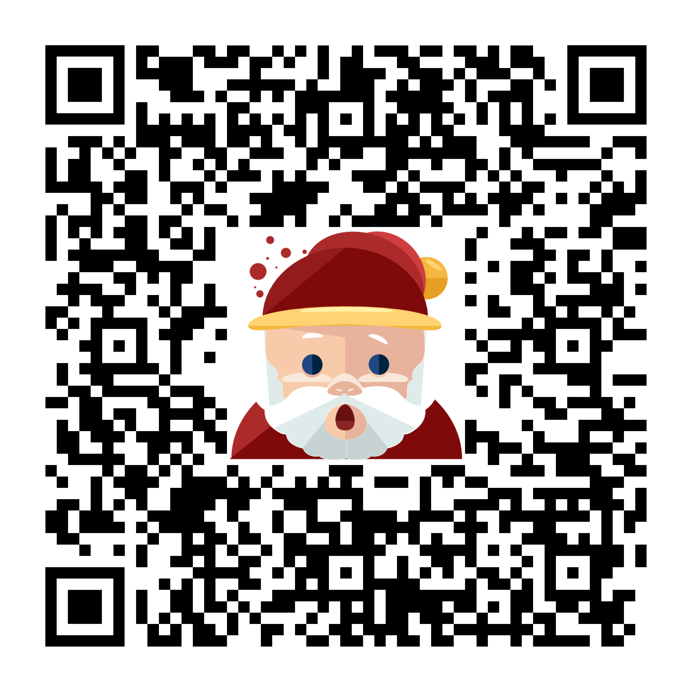
Thanks for your attention
Download on google play store

